Slide 1
xT, xTa, and nxTa
Big Data Cup submission (so far)
Adrian

Slide 2
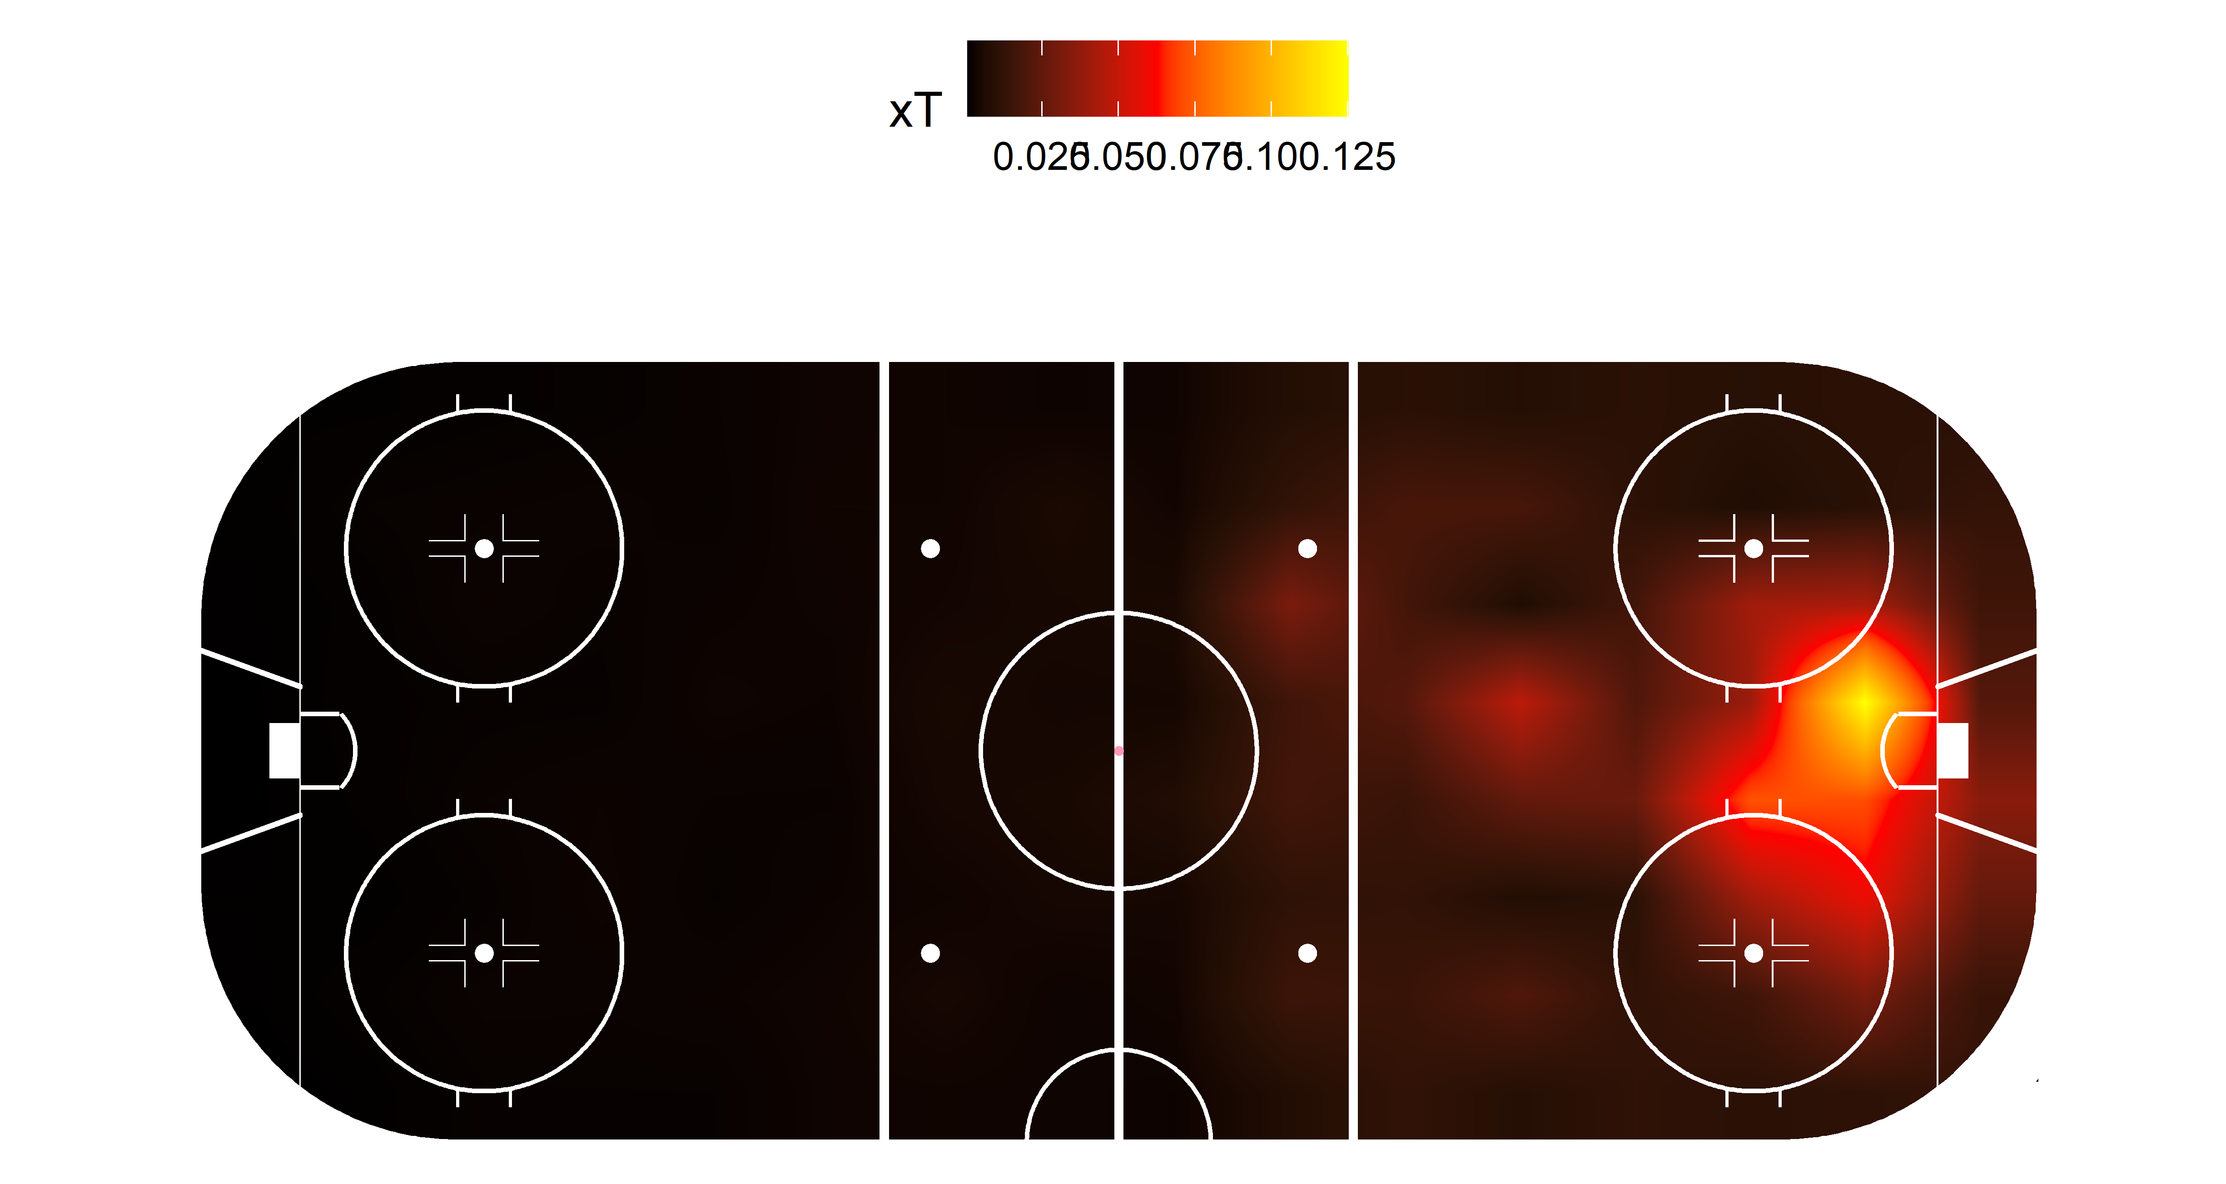
xT is the same model from Karun Singh adapted for hockey

Slide 3
xTa is the same model, but this time we account for time remaining (in bins of 5 min)
Created a xG model to estimate score probability matrices
The variables are:
Euclidean distance from the goal
X cells as dummy variables and as continuous
Y cells as dummy variables
When training the xT model, we split by the 4 time bins, creating 4 subsamples
This is why sample size is a critical factor
We use the corresponding xG matrix for each subsample

Slide 4
nxTa is xTa but accounting for the probability of a turnover
We estimate probability of turning the puck over from every cell to every other cell in the grid
Estimate the xTa that the opposing would have by receiving the puck on every possible turnover cell
We obtain expected opposing xTa (oxTa) by getting a weighted average of all possible opposing xTa
We get de difference

Slide 5
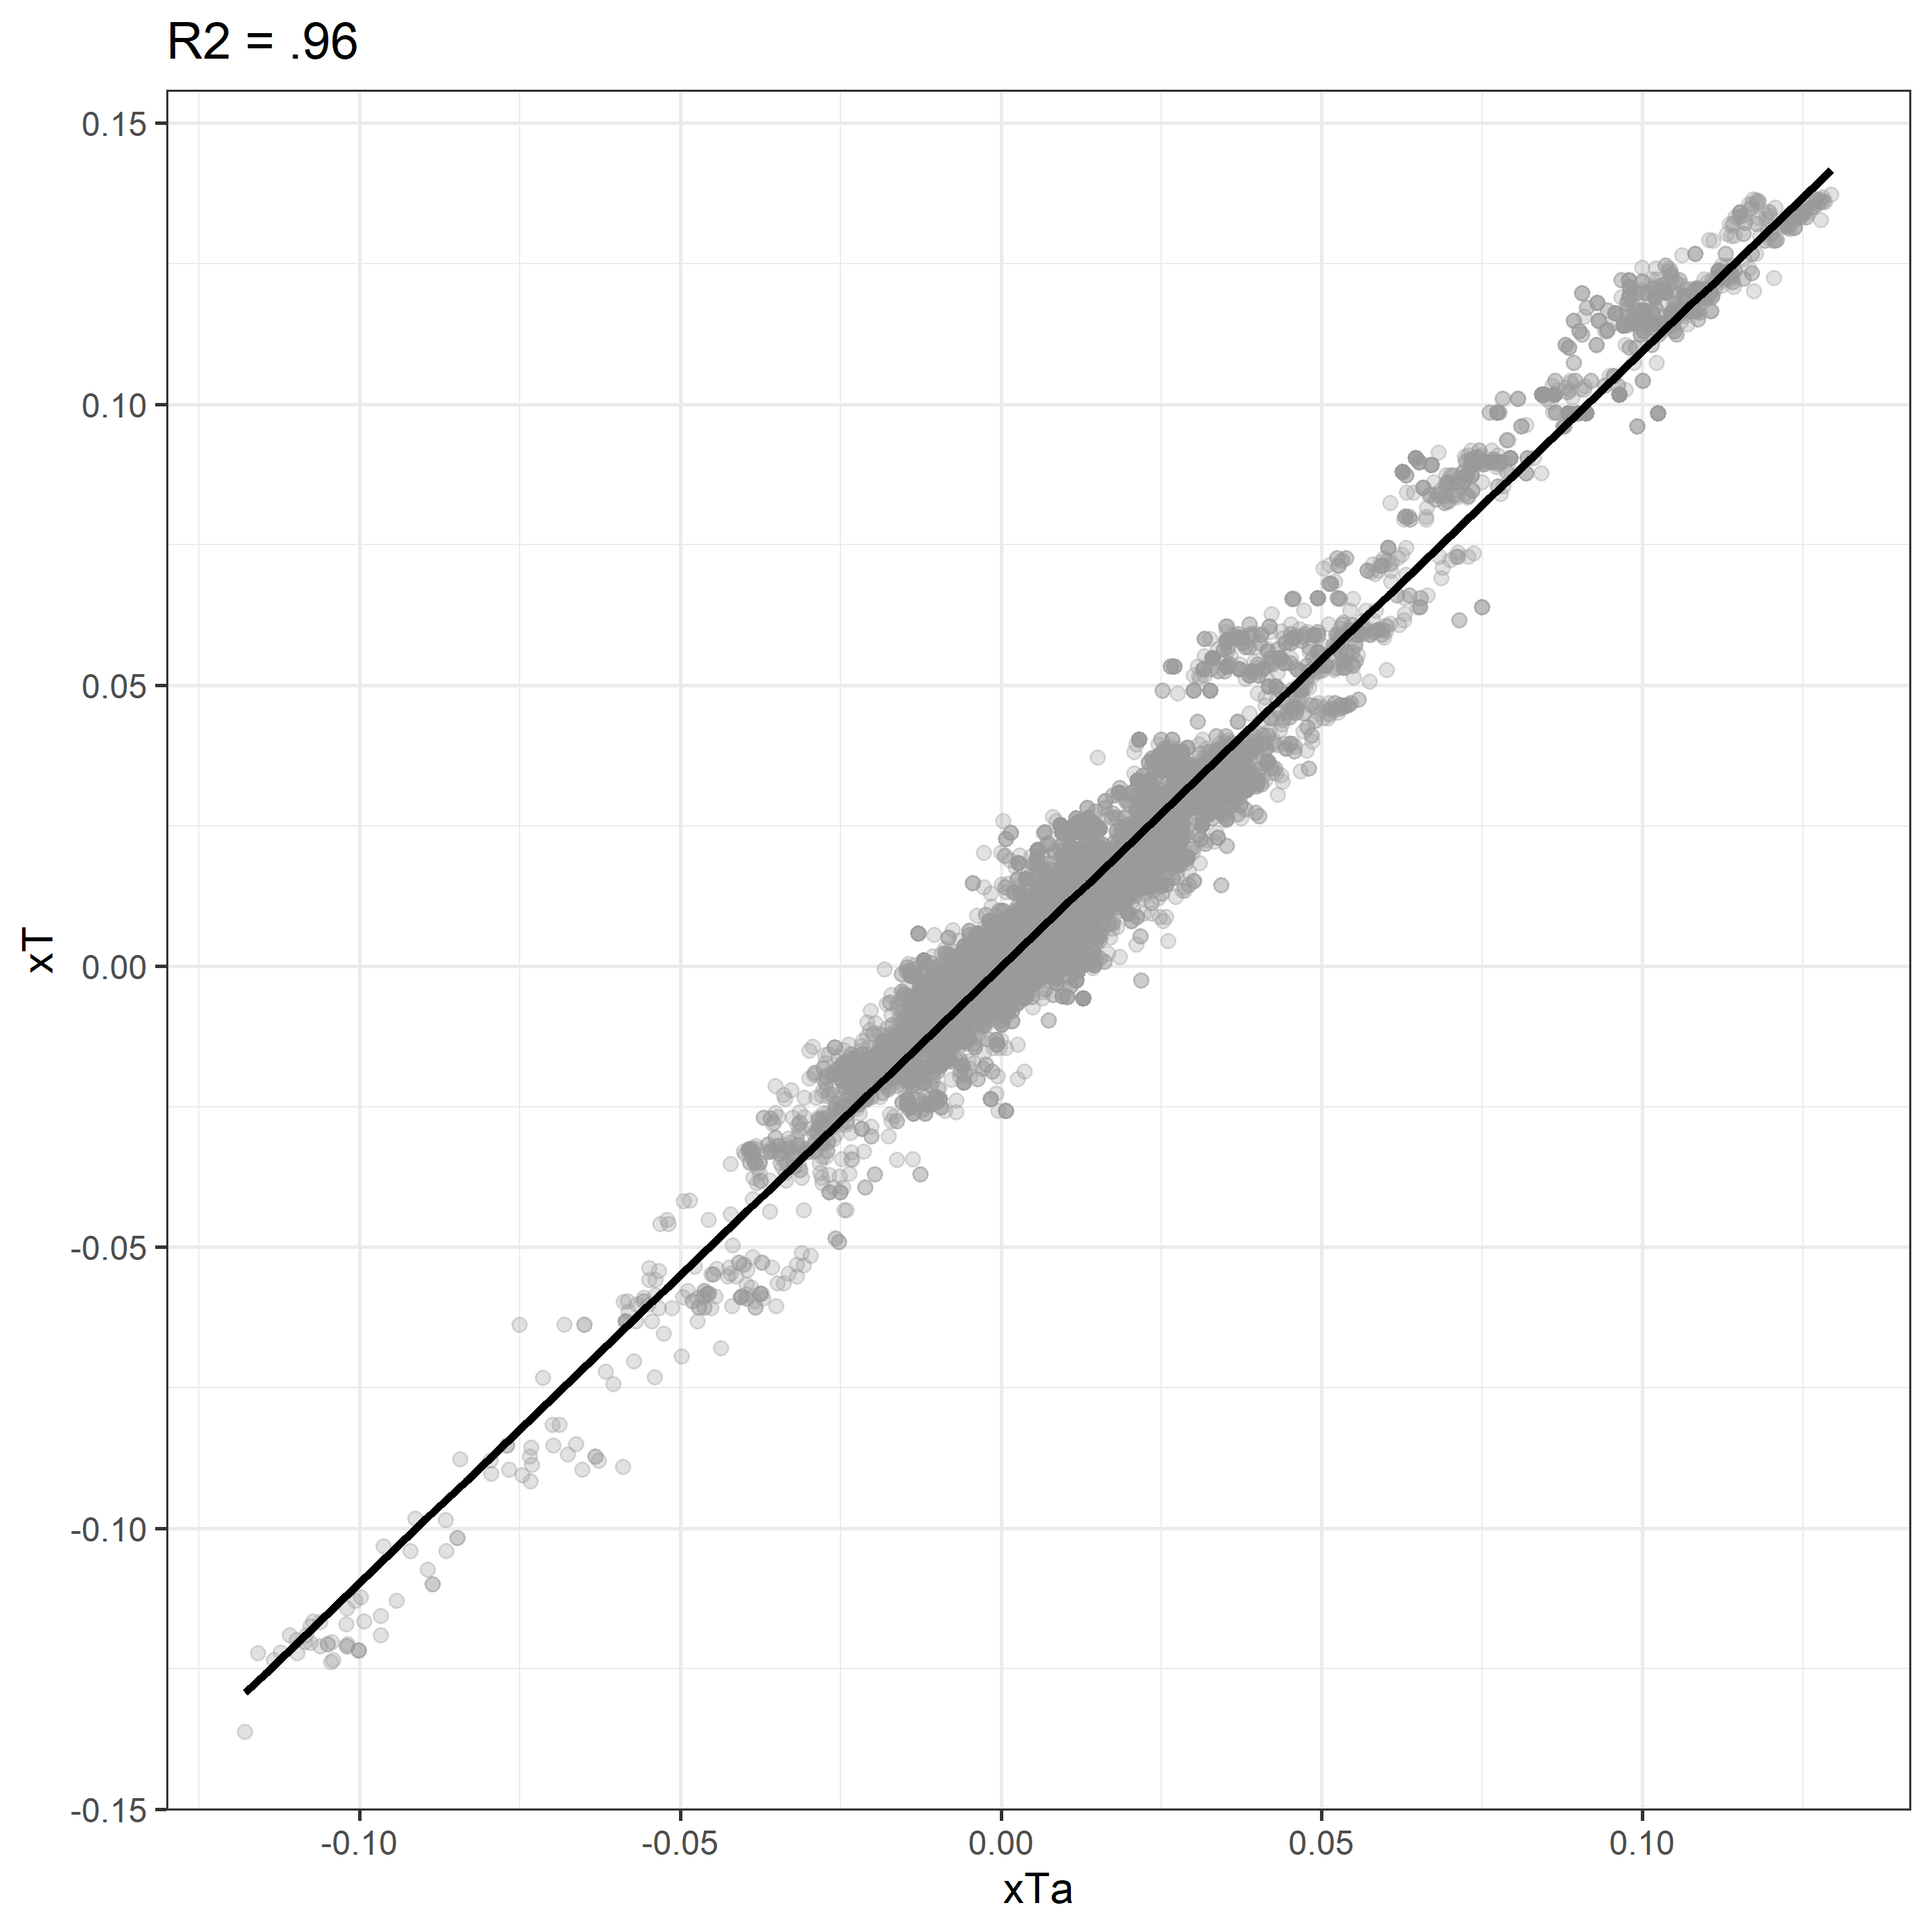
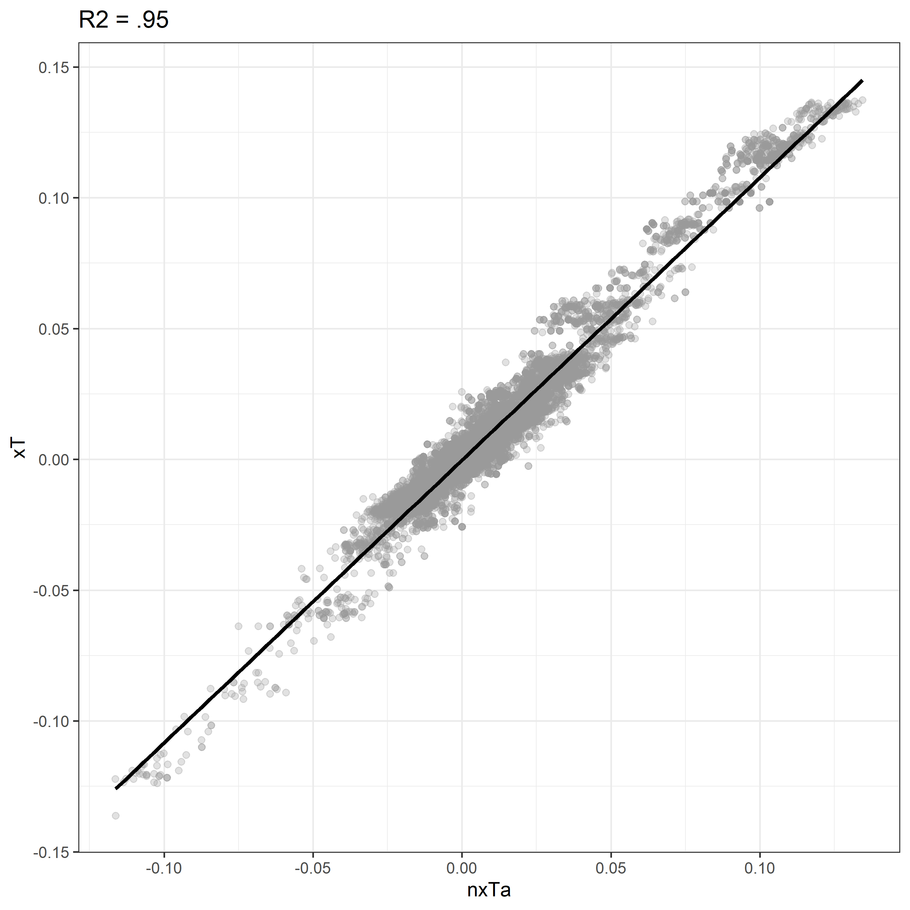
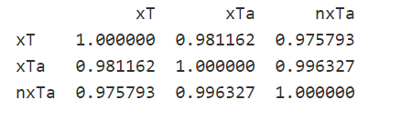
There’s a high level of correlation between the three metrics
By accounting for turnovers we can penalize players for loosing the puck
We can look at the xT lost in each turnover now that probability of turnover is correctly assessed and accounted for
By accounting for time remaining, we our probabilities of score per cell are more reliable and evenly distributed

